Slide 1
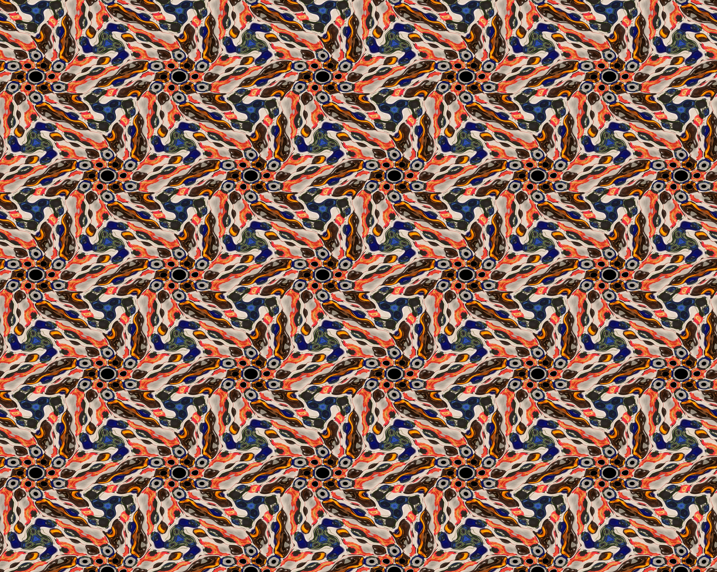
Vibrating Wallpaper
An Exploration By Tim Shur

Slide 2
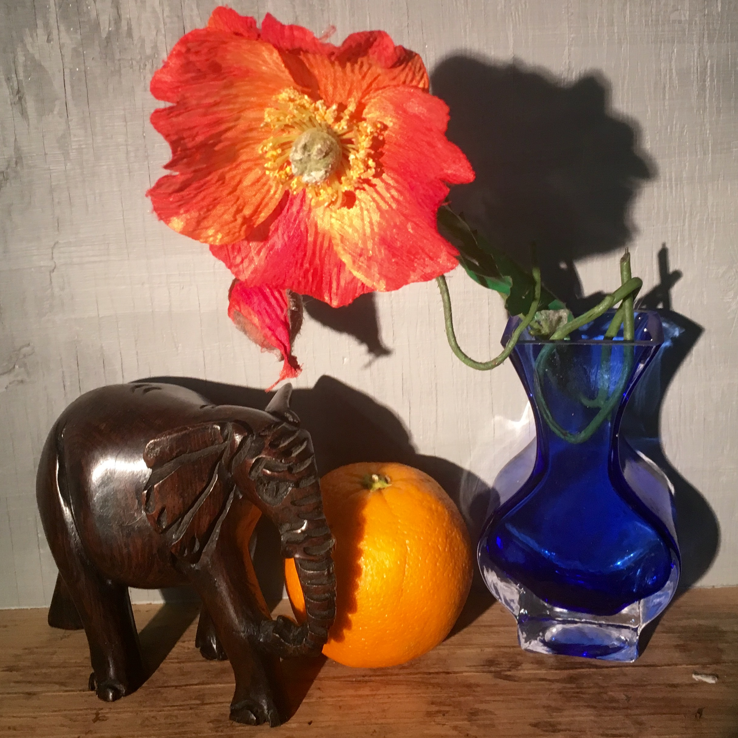
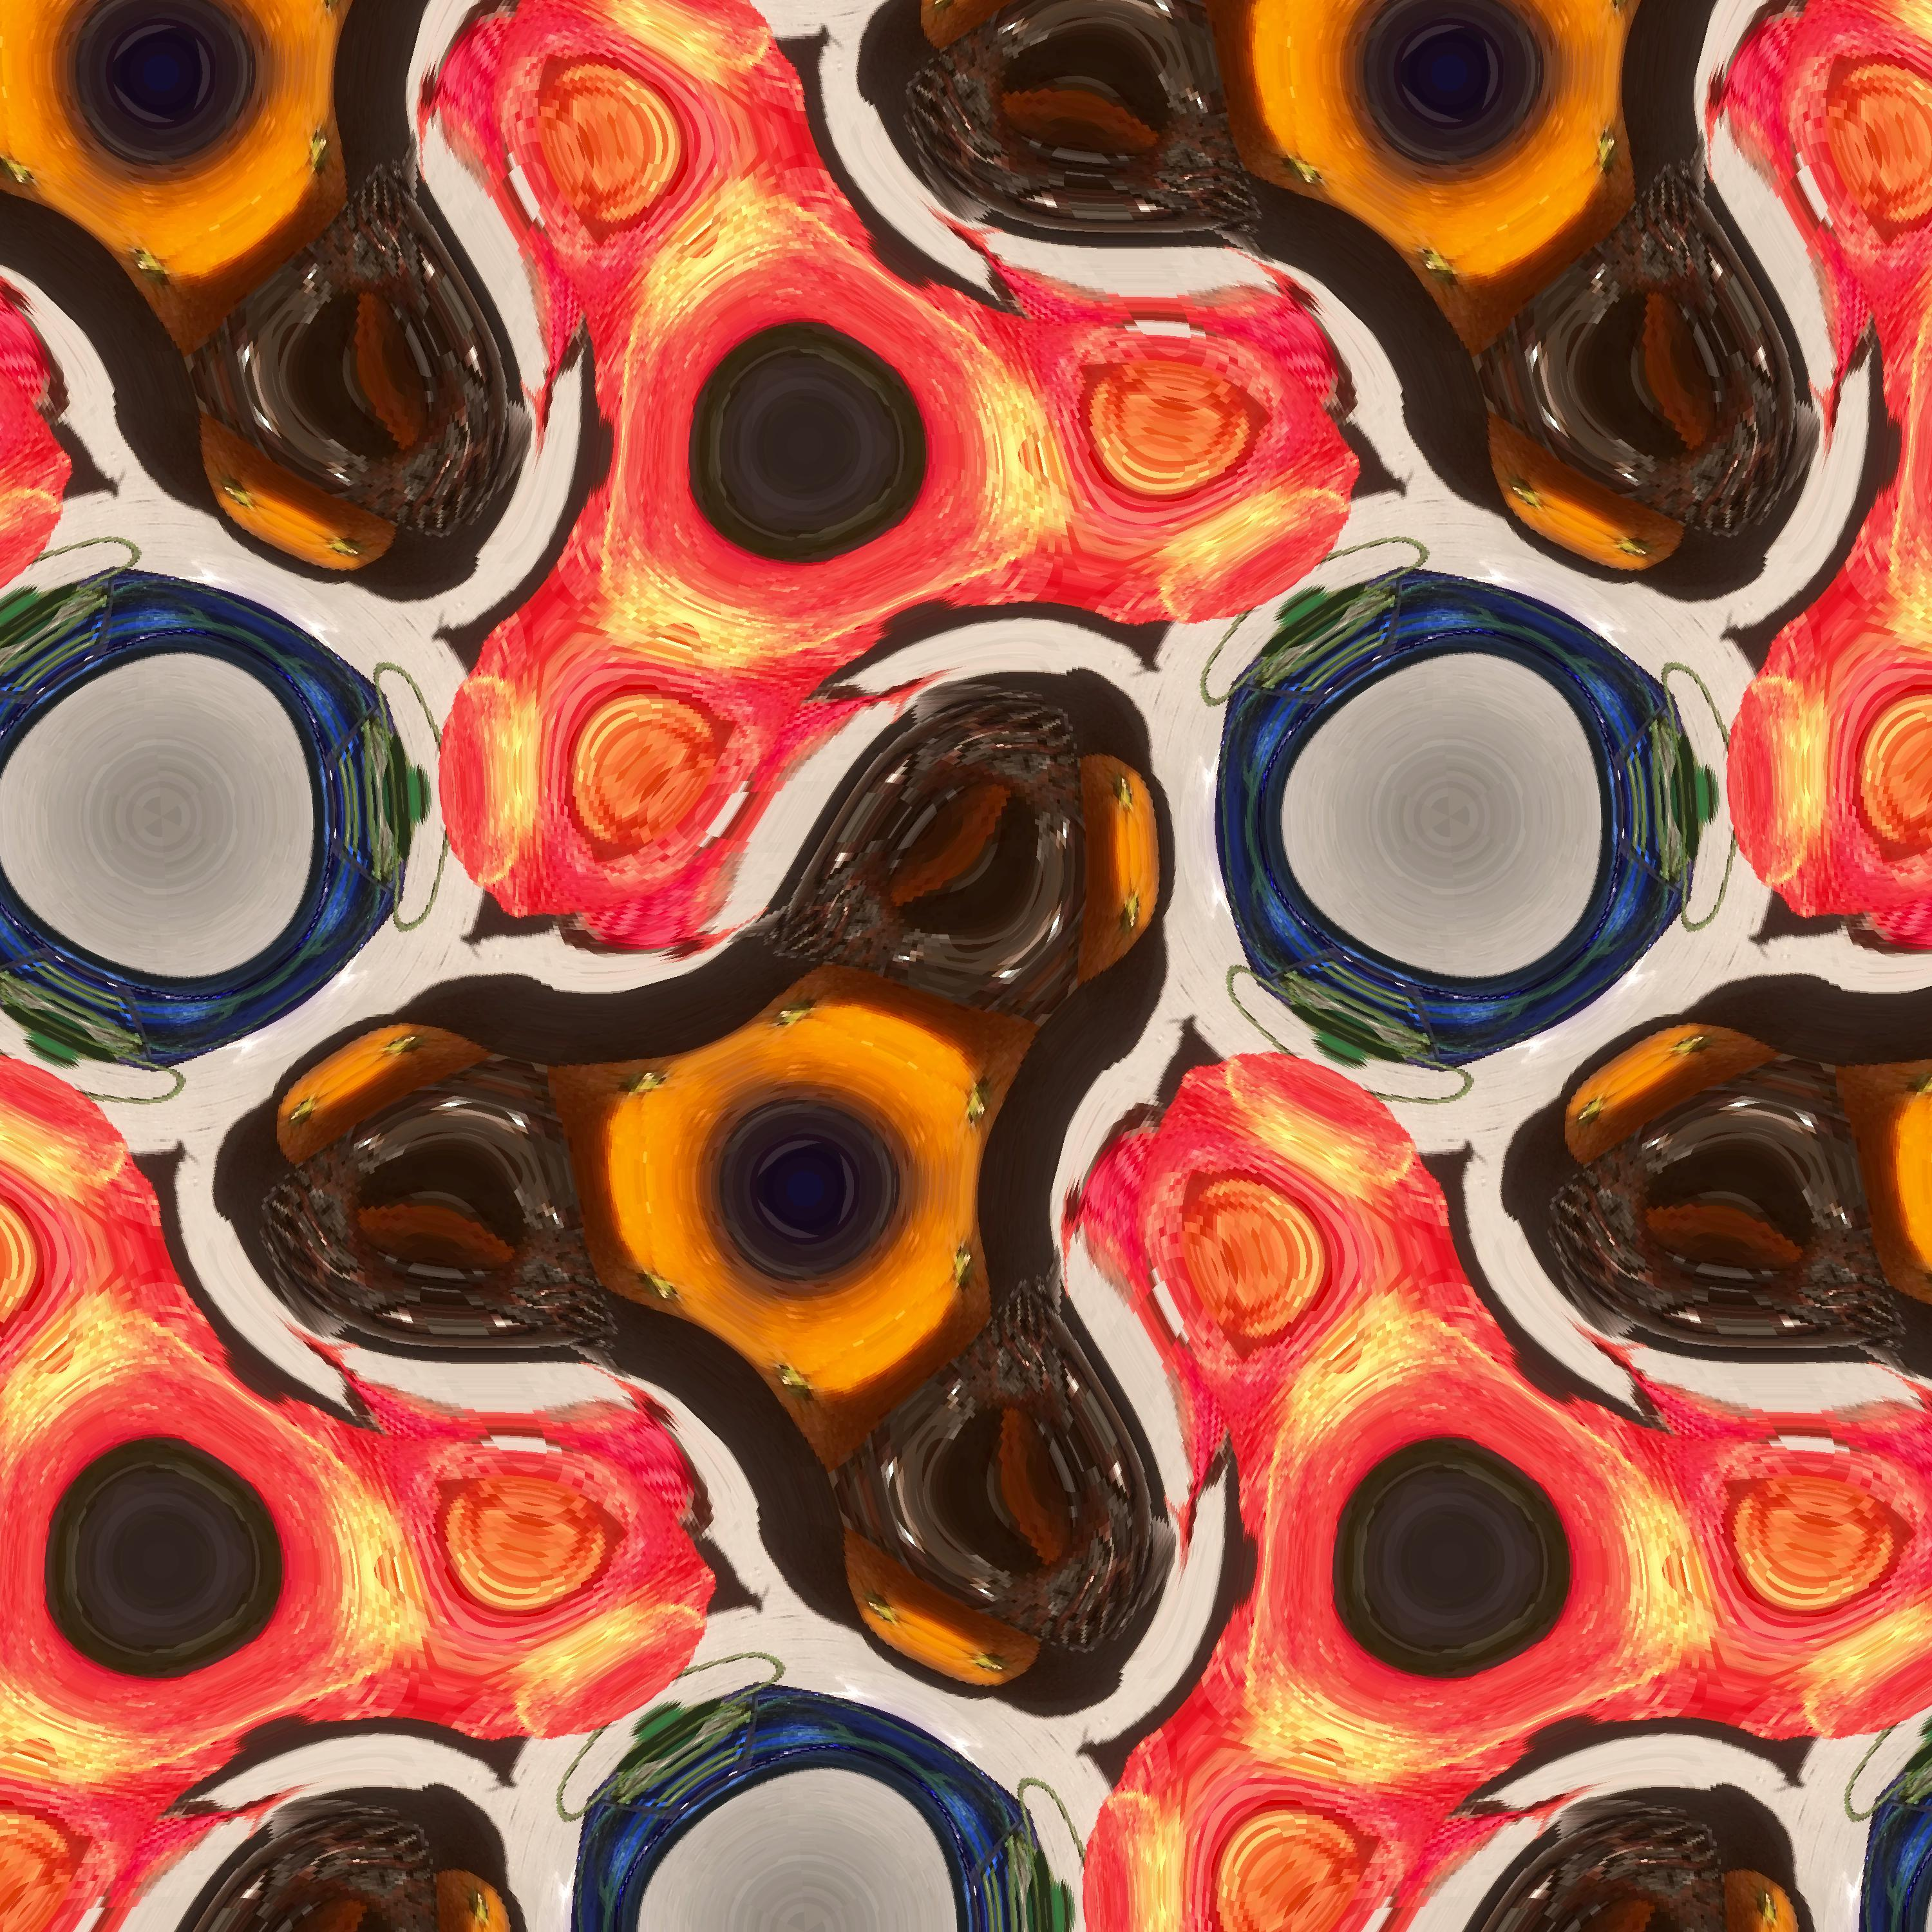
The process
From image to wallpaper to animation

